Slide 1

Test Design Techniques
ISTQB Chapter4
Sep/05/2020

Slide 2

Overview
Let’s explore black-box testing techniques.

Slide 3

What techniques will we explore today?
1. What is equivalence partitioning?
2. What boundary value analysis?
3. What is decision tables?
4. What is state transition testing?

Slide 4


Try example 01
Let's consider the behavior of Order Pizza Text Box Below
Pizza values 1 to 10 is considered valid. A success message is shown.
While value 11 to 99 are considered invalid for order and an error message will appear, "Only 10 Pizza can be ordered“
Here is the test condition
Any Number greater than 10 entered in the Order Pizza field(let say 11) is considered invalid.
Any Number less than 1 that is 0 or below, then it is considered invalid.
Numbers 1 to 10 are considered valid
Any 3 Digit Number say – “100 is invalid”.
Request:
How many test cases do we need to test this requirement?
Write test cases to test this.

Slide 5


Try example 02
Following password field accepts minimum 6 characters and maximum 10 characters
Request:
How many test cases do we need to test this requirement?
Write test cases to test this.
Notes:
hi

Slide 6


Try example 03
Let us consider an example of any college admission process. There is college that gives admissions to students based upon their percentage.
Consider percentage field that will accept percentage only between 50 to 90 %, more and even less than not be accepted, and application will redirect user to error page.
Request:
How many test cases do we need to test this requirement?
Write test cases to test this.

Slide 7

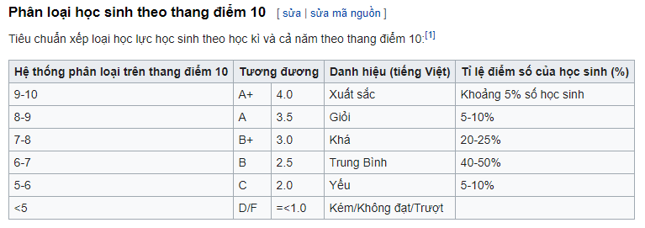
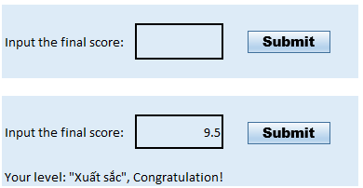
We have the “Phân loại học sinh theo thang điểm 10” as below and the form Request: How many test cases do we need to test this requirement? Write test cases to test this.
Try example 04

Slide 8
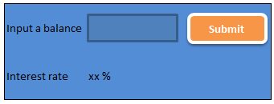
Try example 05 1. Do you have any questions about the Requirement? 2. How many test cases do we need to test this requirement? 3. Write test cases to test this.
For example, a savings account in a bank earns a different rate of interest depending on the balance in the account.
In order to test the software that calculates the interest due, we can identify the ranges of balance values that earn the different rates of interest.
For example, if a balance in the range $0 up to $100 has a 3% interest rate, a balance over $100 and up to $1000 has a 5% interest rate, and balances of $1000 and over have a 7% interest rate.

Slide 9
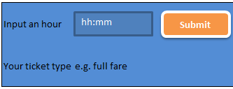
Try example 06
1. Read the following scenario.
2. Are there any questions you have about this 'requirement'? Is anything unclear?
3. Derive test cases
Scenario: If you take the train before 9:30 am or in the afternoon after 4:00 pm until 7:30 pm ('the rush hour'), you must pay full fare.
A saver ticket is available for trains between 9:30 am and 4:00 pm, and after 7:30 pm.

Slide 10



Try example 07
Determine equivalence partition for the follow statements:
6.1. State - the standard Post Office two-character abbreviation for the states, districts, territories, etc. of the United States.
6.2. Last Name - one through fifteen characters (including alphabetic characters, periods, hyphens, apostrophes, spaces, and numbers).
6.3. User ID - eight characters at least two of which are not alphabetic (numeric, special, nonprinting).
6.4. Student ID - eight characters. The first two represent the student's home campus while the last six are a unique six-digit number. Valid home campus abbreviations are: AN, Annandale; LC, Las Cruces; RW, Riverside West; SM, San Mateo; TA, Talbot; WE, Weber; and WN, Wenatchee.
What test technique can be applied?
What is it all about?
How many test cases are enough?

Slide 11
What Boundary value analysis (BVA)?
Boundary value analysis Boundary value analysis (BVA) is based on testing at the boundaries between partitions. If you have ever done 'range checking', you were probably using the boundary value analysis technique, even if you weren't aware of it. Note that we have both valid boundaries (in the valid partitions) and invalid boundaries (in the invalid partitions).
As an example, consider a printer that has an input option of the number of copies to be made, from 1 to 99. We will test with
0
1
99
100

Slide 12
Scenario: If you hold an 'over 60s' rail card, you get a 34% discount on whatever ticket you buy. If you are traveling with a child (under 16), you can get a 50% discount on any ticket if you hold a family rail card, otherwise you get a 10% discount. You can only hold one type of rail card. Produce a decision table showing all the combinations of fare types and resulting discounts and derive test cases from the decision table.

